Slide 1
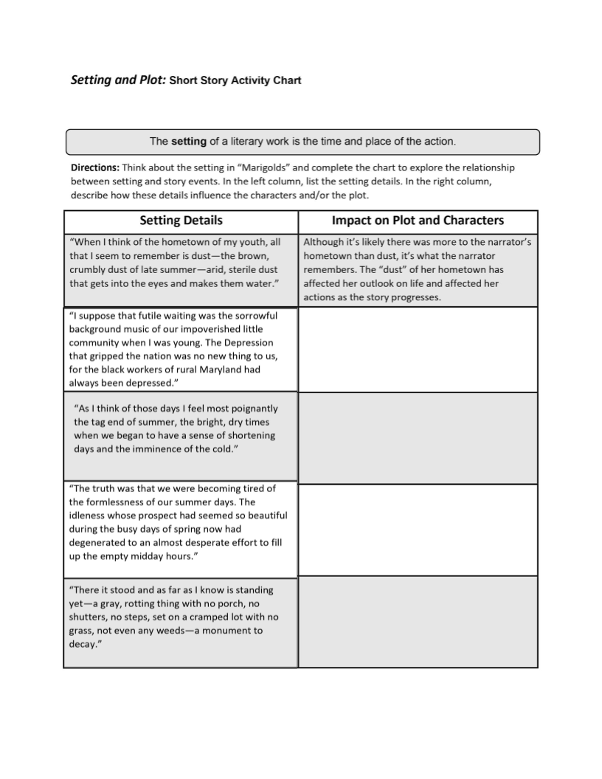
Insert text
Insert text
Insert text
Insert text

